Slide 1
Procurement of personnel

Slide 2
Procurement of the personnel Involves three important steps:
1. Determination of the kind or quality of personnel needed.
2. Determination of the quantity of personnel required
3. Recruitment, selection, placement and induction.

Slide 3
Determinants of the kind or Quality of personnel
A knowledge of the nature and requirements of jobs is a fundamental prerequisite for determining the kind or quality of personnel needed. The securing of this knowledge entails three closely related steps : the analysis of jobs, the writing of job descriptions and the preparation of job specification.

Slide 4
Job Analysis
Job analysis is the process by means of which a description is developed of the present method and procedures of doing a job, physical conditions in which the job is done, relation of the job to other jobs and other conditions of employment. Job analysis is intended to reveal what is actually done as opposed to what should be done. Therefore, if a man is found doing some activity not required of that job, it should still form part of the job analysis except where the immediate removal of that activity is possible. The purpose of job analysis is not to describe an ideal but to show the management how at the moment a particular job is being carried out.

Slide 5
Various points on which information may be gathered for job analysis are as follows:
1. Job title
2. Alternate titles
3.Work performed
4. Equipment used
5. Tools used
6.Materials used
7. Reports and records made
8. Relation of the job to other jobs
9. Education (general, technical and on-the-job) required
10. Experience (type and duration) required

Slide 6
11. Physical effort required
12. Mental effort required
13. Visual attention required
14. Responsibility (in terms of typical damage, money value and normal consequences) equipment, tools, materials and records and reports.
15. Discomforts
16. Hazards (in terms of typical injury and preventive measures taken)
17. Supervision (close or general) received
18. Supervision (close or general given
19. Any other details (e.g., number of persons men and women employed)

Slide 7
Job Analysis Techniques
Some Important job analysis techniques are as under :
1. Functional Job Analysis
2. Critical Incidents
3. Job Elements
4. Position Analysis
5. Physical Abilities Requirement.

Slide 8
Functional Job Analysis
This technique focuses on identifying the key competencies required for a job. A competency is defined a behaviour rather than a skill or ability.
In this technique trained professional develop information about the job on the basis of workers interviews, observation and training manuals.

Slide 9
Critical Incidents
Following are the steps involved in this technique: First of all, the job analyst asks workers, supervisors, managers and others to think of the most recent examples of workers whom they saw performing at a very high and at a very low level and to describe their on-the-job behaviour.
Next, all incidents are collected. According to Flanagam an analysis of simple jobs requires 50 to 100 incidents, of skilled and semi-skilled jobs from 1000 to 2000 incidents and of supervisor jobs from 2000 to 4000 incidents.
Next, the collected incidents are transferred to index cards and informants are asked to group them independently into various categories which collectively describe the content of the job. For example, in the case of a sales person some such categories may be "promptness of service", "interaction with customers" "fairness", "self-confidence, and so on.

Slide 10
Next, independent groupings are compared and differences in categorization are removed.
Finally, a detailed outline of the contents of job emerges. It gives an objective picture of what behaviours constitute a specific job. The merit of this technique is that the information collected under it can also be used for other puposes such as performance appraisal and job desgin. The demerits are:
(a) Much of employees time is spent in recording incidents. Production thus suffers.
(b) Number of incidents should always be large lest some aspects of the job may be overlooked.

Slide 11
Job Elements
This technique focuses on describing a job in terms of various elements (such as knowledge, skills, ability, willingness etc.) that a worker uses in performing a specific job.
The steps involved are as under:
First of all, supervisors and workers meet in a brainstorming session to identity as many of the elements of the job as possible.
Next, each identified element is rated in terms of:
its importance in selecting superior workers;
its availability (in candidates) when making selections;
its consequence of ignoring it when making selections.

Slide 12
Finally, on the basis of statistical analysis of the above ratings those elements which are most important in selecting superior workers are determined.
The merit of this technique is that the information about job elements collected under it serves as a base for developing curricula for training programmes. The demerits are that this technique is time-consuming and costly.

Slide 13
Position Analysis Questionnaire
Contrary to the above technique which assumes that jobs vary in their elements, this technique assumes that all jobs have common elements. The total number of these elements is 194 and they are classified under six categories as shown below:
Category
1. Information input
2. Mental processes
3. Work output
4. Relationships with other
5. Job context
6. Other job characteristics, Example: Irregular hours
The merits of this technique are its easy data collection and their replicability.
The demerit is that the questionnaire is sometimes not comprehensible to the workers.

Slide 14
Physical Abilities Requirements
Unlike all the above techniques this technique focuses on collecting information about physical requirements of the job. Uncertainty about physical requirements results in women being discriminated against in selections for certain jobs and selected men proving themselves unfit and leaving the job later on.
In this technique supervisors and workers are asked to classify and rate tasks in terms of sensory, perceptual, cognitive, psychomotor and physical abilities.

Slide 15
How to obtain Data for Job Analysis
Following methods may be used to collect information for a job analysis:
1. Questionnaire. This method is usually used to obtain information about jobs through a mail above, The job incumbents who can easily express themselves in writing are asked to provide data about their jobs in their own words. This method is, therefore, best suited to clerical workers. But it is often a very time-consuming and laborious process to analyse the data obtained in this manner.
2. Checklist. This method requires the worker to check the tasks he performs from a long list of Possible task statements. However, in order to prepare the checklist, extensive preliminary work is required in collecting appropriate task statements. While checklists are easy for the incumbent to respond to, they do not provide an integrated picture of the job in question. They are easily administered to large groups and are easy to tabulate.

Slide 16
3. Interview. In this method a group of representative job incumbents are selected for extensive interview-usually outside of the actual job situation. The interview may be carried out either individually or in a group to save time. The replies obtained from the interviewees are then combined into a single job description.
This method though very costly and time-consuming helps in getting a complete picture of the job. Very often many such things are revealed about the job which were never previously known. Sometimes persons leaving the job are also interviewed to give their views about the job.
4. Observation. This method can be followed right on the job. The analyst observes the incumbent as he performs his work and questions him to get the required data. Besides being slow and costly, this method also interferes with normal work operations. Some employees do not like someone taking a hard look at their performance. However, it generally produces a good and complete job description. This method is particularly desirable where manual operations are prominent and where the work cycle is short. Working conditions and hazards can also be better described when observed personally by the analyst.

Slide 17
5. Participation. In this method the job analyst actually performs the job himself. In this way he is able to obtain first-hand information about what characteristics comprise the job under investigation.
This method is fairly good for simple jobs but in case of complex jobs advance training of the analyst becomes necessary. The method is also time-consuming and expensive.
6. Technical Conference. In this method information about the characteristics of the job is collected from the experts- usually the supervisors- and not from the actual job incumbents. One important drawback of this method is that the experts may at times show poor knowledge about the job which they are not actually performing themselves and may give answers based upon their past experience.

Slide 18
7. Self-recording or Diary. In this method the job incumbent is asked to record his daily activities each day using some type of logbook or diary. The method is good in that it systematically collects a great deal of information about the nature of and the time spent on various activities during the day by each incumbent. But it is very time-consuming and the incumbent may start complaining that he spends more time in writing his diary than in doing his job. This method is particularly useful for high-level managerial jobs.
8. Critical Incident. In this method the supervisor is asked to provide instances of on-the-job behaviours of people which he considers to be noteworthy. Such instances can be both of good and bad on-the-job behaviour. The number of such instances can be as many as the supervisor can recall. These instances can provide information about critical aspects of the job, but the method does not provide an integrated picture of the entire task.

Slide 19
Job Description
The results of a job analysis are set down in job description. The main points to be included in a job description are:
the location of the job- division, department, branch or section;
the title of the job;
the job title of the individual to whom the job holder is responsible;
the job grade;
the job titles of any individuals responsible to the job holder and the number of employees he supervises;
a brief description of the overall purpose of the job;
the main tasks carried out by the job holder-these should be listed either in chronological order or in their order of importance;
details of the equipment or tools used or any special requirements to deal with people, inside or outside the company ,characteristic position of the job holder, his isolation or association with others;
special circumstances such as shifts or night work, overtime or weekend working, heavy lifting, exceptionally monotonous work, unpleasant or dangerous working conditions, travelling required, and so on.

Slide 20
Job Specification
A job specification (also called man specification) is a statement of the minimum acceptable human qualities necessary to perform a job. satisfactorily. Making job description as its base, it prescribes the abilities and qualities that a worker should possess in order to hold the job in question. The exact list of information varies according to the company and the uses to which the job specification is to be put.
For example, it a job specification is to be used only for hiring decisions it may list only the physical, educational, experience and skill requirements of the job but if it is to be used also for appraising an employee's performance or for career counselling then it must clearly lay down the performance standards and the career paths as well. It should be remembered that preparing a complete and correct job specification is relatively difficult as compared with preparing a complete and correct job description. There is always considerable disagreement concerning the human requirements for the work.

Slide 21
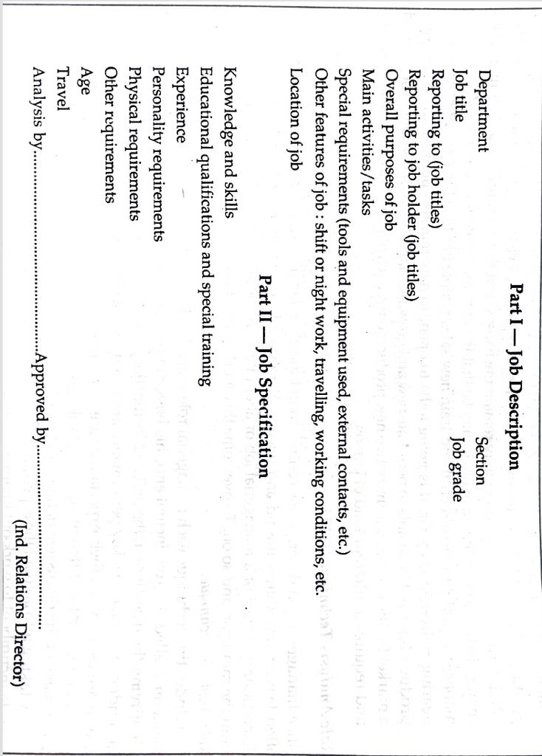

Slide 22
Determination of the Quantity of Personnel (Manpower Planning)
The second step in the procurement of personnel is the determination of the number of persons which should be hired. This forms part of Manpower Planning. Manpower planning may be defined as a strategy for the procurement, development, allocation and utilisation of an enterprise's human resources. Procurement of personnel deals with the task of recruitment and selection of workers of the desired skill-mix. Training and development plans help in keeping and raising the skill-standards of workers. Manpower allocation plans help in mitigating shortages and surpluses in manpower supply through promotions and transfers. Manpower utilisation deals with the dynamics of leadership and motivation.

Slide 23
Objectives of Manpower Planning
The objectives of manpower planning are mainly:
1. To ensure optimum use of human resources currently employed;
2. To determine future recruitment level;
3. to provide control measures to ensure that necessary resources are available as and when required;
4. To anticipate redundancies and avoid unnecessary dismissals;
5. To forecast future skill requirements to serve as a basis for training and development programmes,
6. To assess future housing needs of employees;
7. To cost the manpower component in new projects;
8. To decide whether any of the enterprise's activities, e.g, maintenance, be off-loaded or sub-contracted.

Slide 24
Manpower Planning Process
Following are the steps involved in manpower planning process:
(a) Analysis of the system, (Goals, Uncontrollable variables or constraints, Controllable variables, expectations about behaviour)
(b) Deciding the time horizon of the plan, (the planner must determine in advance the time horizon of his plan since this will affect how much is changeable within the system)
(c) Forecasting the demand for and the supply of manpower,
(The manpower demand forecast stems from the objectives of the organisation as represented in the company’s plan. Hence, to be able to forecast manpower demands in the future, the manpower planner must have a detailed knowledge of the company’s future achievements targets)
(Manpower is one aspect of manpower forecasting, the other aspect is the supply of manpower to fulfill the demand. The supply of manpower may be obtained from internal or external sources).

Slide 25
(d) Reconciliation, (when the cost implications of the manpower plan are found to be not compatible with the company’s finances, the manpower needs and programmes will have to be re-examined and reconciled.
(e) Preparation of action plans, (Recruitment, redeployment, redundancy, training, improvement in productivity and retention of employees).

Slide 26
Recruitment, Selection and Induction
After the quality and quantity of personnel needs have been decided the task of its recruitment and selection begins.
There are a number of steps involved in this task:
1. Placing the requisition,
2. Recruitment,
3. Selection,
4. Placement, and
5. Induction.

Slide 27
Placing the Requisition Indent
As soon as the blueprint for future recruitment activities is ready, the line manager or the head of a department can submit an indent for recruitment to the personnel department. An indent usually specifies the jobs or operations or positions for which persons are required, the number to be recruited, the time by which the persons should be available, their duration of employment (if needed temporarily), the salary to be offered and any other terms and conditions of employment which the indenting officer feels necessary. This form is prepared in duplicate, one copy being sent to the personnel department, and the other retained by the requisitioning department for reference.

Slide 28
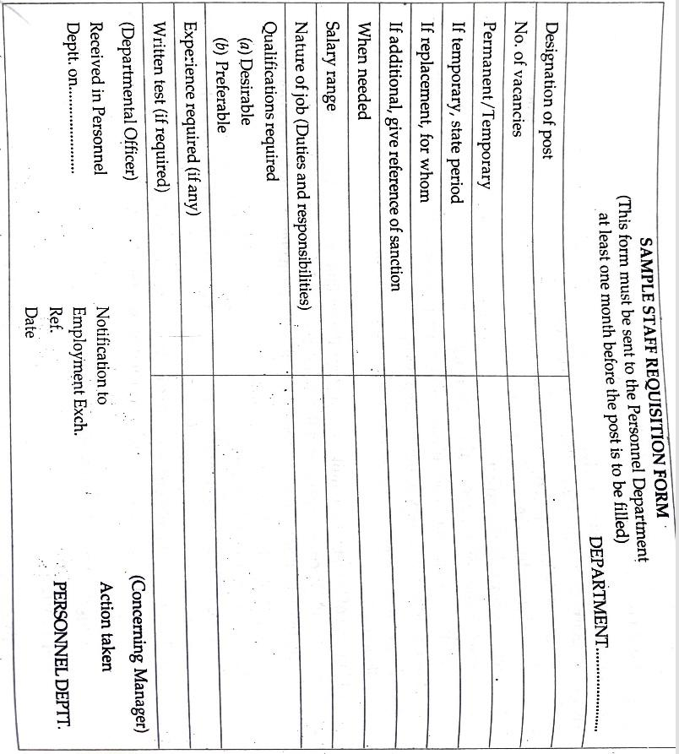

Slide 29
Recruitment
Once the requisition or the indent has been received, the personnel department can begin the process of recruitment. Some people define recruitment as the process of searching prospective workers and stimulating them to apply for jobs in the organisation. According to this definition recruitment is a prospecting job where organisations make search for prospective employees. In practice, however, prospective employees too seek out organisations just as organisations seek out prospective employees. Therefore, the job of recruitment is based on the mating theory where success of both the parties is critically dependent on timing. Unless the two searches synchronise, conditions are not ripe for recruitment to succeed. The synchronisation in its turn depends on three factors:

Slide 30
1. There should be a common communication medium. If an organisation advertises its vacancies in a paper which is never read by the job-seekers, its efforts will go waste.
2. Only the qualified job-seeker must perceive a match between his personal characteristics and prescribed job requirements or the job-preview given by the company. This will minimise the cost of processing unqualified candidates.
3. The job-seeker must be motivated to apply for the job. Among important factors that can affect his motivation are image of the organisation, attractiveness of the job, internal organisatonal policies (such as "promote from within wherever possible") and government influence (such as number of seats reserved for different classes of individuals").

Slide 31
Sources of Recruitment
The sources of recruitment can broadly be classified into two: internal and external.
Internal sources refer to the present working force of a company. In the event of a vacancy, some one already on the payroll is promoted.
Filling a vacancy from internal sources by promoting people has the advantages of increasing the general level of morale of existing employees, of reducing the cost of selection and providing to the company a more reliable information about the candidate's suitability who has already worked with the company on a lower post.
The major weaknesses of this source are that it results into inbreeding depriving the organisation of a fresh outlook, originality and initiative, offers limited choice, decreases morale levels of those not selected and generates infighting among the rival candidates for promotion.

Slide 32
external sources of recruitment
Advertisement in Newspapers.
Employment Exchanges
Field trips
Educational institutions
Labour contractors
Employee referrals
Unsolicited applicants
Labour Unions

Slide 33
Selection
Selection, as the name implies, involves picking for hire a sub-set of workers from the total set of workers who have applied for the job. Selections are done comparing the requirements of a job with the applicant's qualifications. An attempt is made to find a round peg for a round hole. In doing so naturally many applicants are rejected. This makes selection a negative 'function’.
In contrast recruitment is a positive function because in it an attempt is made to increase the number of applicants per job opening. It is not always essential for an organisation to have a selection programme. The need to install such a programme arises only when there is a labour surplus or when there are individual differences in job performance or when there is need to identify people with a hobo syndrome, i.e., tendency to frequently change jobs. This means that when there is a labour shortage or when the work is such that no large differences in job performance exist or when there is no problem of labour turnover there is no teed to have a selection programme.

Slide 34
Selection Techniques
Following are some common selection techniques :
A selection technique is typically referred to as "predictor" because it helps in distinguishing good“ and "poor" workers by predicting their future job success.
1. Application Scrutiny: The main purpose of application scrutiny is to identify those candidates who fit the job specification and can be called later for the interview and testing sessions. Organisations generally use different versions of the application form for different levels of workers. Thus, an organisation may have one application form for factory and clerical workers, another for middle level supervisors and still another for top-level managers.

Slide 35
We can classify application forms as under:
Structured application form
Unstructured application form
Weighted application form

Slide 36
2. Interview
An interview is a face-to-face, observational and personal appraisal method of evaluating the applicant where the interviewer who is higher in status is in a dominant role. If there were no differences of status and roles, it would be a meeting. Two interviews-preliminary and final generally occur during the selection process. Where a large number of candidates are asking for application forms a preliminary interview becomes a necessity. Its purpose is not to make a detailed probe of qualifications but to refuse application forms to those who cannot be employed because of such reasons as overage, disqualifying physical handicaps, and lack of required experience or training. The final interview is generally conducted in two stages. In the first stage, some official of the personnel department makes a comprehensive appraisal of the candidates and recommend the successful to ones to the line department which was made the requisition. In the second stage, the line official interviews these candidates and makes final selections.

Slide 37
Kinds of Interview
Direct planned interview
Indirect Non-directive interview
Patterned interview
Stress interview
Systematic depth interview
Panel interview
Group interview
Walk-in interview

Slide 38
Procedure for an Interview
Following steps are generally involved in an interview procedure:
Reviewing Background Information. Pertinent information about the candidate should be collected and noted beforehand. This preparation saves time and mental effort during the interview and enables the interviewer to sketch in advance at least a general picture of the candidate.
Preparing a Question Plan. Every interview should have a question plan. It is useful for inexperienced interviewers to have this written down in front of them so that questions can be ticked off as they are dealt with. The National Institute of Industrial Psychology (Great Britain) provides a 7-point plan for this purpose covering physical make-up, education and occupational attainments, basic intelligence, special aptitudes, intellectual and social interests, nature and domestic and social background.

Slide 39
(3) Creating a Helpful Setting. Most interviews have overtones of emotional stress for the applicant. Success in interviewing depends on reducing this stress. This can be achieved if the following conditions are present at the place of interview: privacy and comfort, atmosphere of leisure, freedom from interruptions, authentic feeling for and interest in the candidate.
(4) Conducting the Interview. Interviewing is much like fishing, where it is often necessary to change depth, lure and location in order to get a bite. It is, therefore, necessary to use a number of different approaches during the course of an interview.
(5) Concluding the Interview. In the final few moments the interviewer guides the interview to a close. After the candidate leaves, the interviewer looks over his notes, recalls his impressions, collates his observations and makes a provisional appraisal before seeing the next candidate. He fills up the interviewer's Rating Sheet meant for this purpose. A well-drafted Rating Sheet forces the interviewer, to think carefully on various factors relevant to the job.

Slide 40
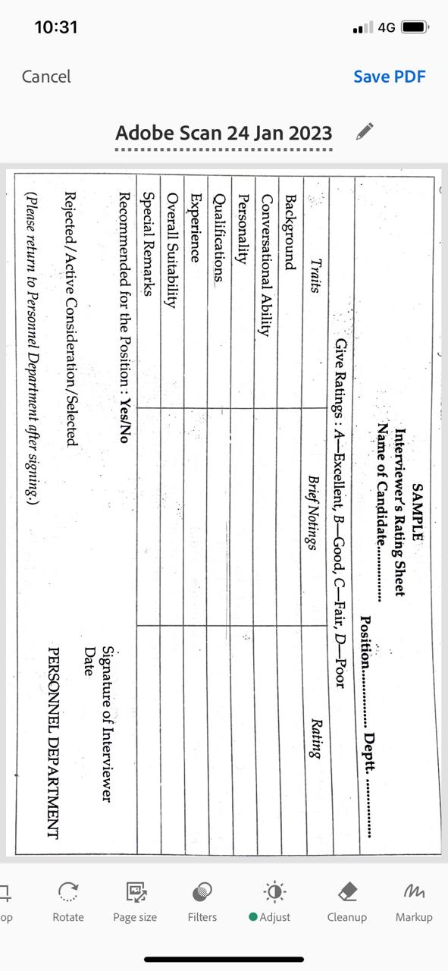

Slide 41
Advantages and limitations of interviewing
Interviewing has two big advantages over other methods. These are as follows:
It can fill information gaps and can correct questionable responses.
(b) It can effectively bring out the behavioural characteristics of the applicant. the interviewer can easily find out whether the applicant is likely to get along with others in the organisation or hot, where can his talents be utilised most effectively, and so on.

Slide 42
It is sometimes contended that interview is an unreliable tool of selection because it has the maximum element of subjectivity. The same candidate may be rated differently by different interviewers.
Interviewer's Bias and his Pseudo-scientific Premises.
Interviewers differ in their bias related to sex, ethnic group, age, etc. Hence, they may match 'men and prejudices' instead of 'men and jobs'. Closely allied to bias are most of the premises of such pseudo-sciences as graphology, palmistry, phrenology, etc. Different interviewers may differently use their knowledge of these subjects in interviewing. The graphologist, on the basis of his interpretation of the candidate's handwriting, may reject a candidate and the phrenologist may on the basis of the candidate's shape of head, select him. The fact is that all such devices are unreliable.

Slide 43
2). Temporal Order of Interview Information: It has been found that interviewers typically make some tentative decisions about candidates early in the interview. Thus, if some unfavourable information about a candidate comes up early before an interviewer, it may lead him to an early negative decision, and vice versa, although the total favourable and unfavourable information presented to him collectively may remain the same.
3). Temporal Order of Interview and Application Form Information: Where a candidate is being separately rated both on the basis of his application form and interview, the order in which the two informations are being rated is important.
It has been found that when application forms are rated first, the ratings (whether favourable or unfavourable) are reflected consistently in the interview ratings-the reason perhaps being that the application form information is supposed to be relatively more objective. But when interview is rated first, the rating on the application form depends more on whether the interview rating is favourable or unfavourable: if favourable the rater is more likely to search for negative evidence in the application form rather than to confirm his earlier favourable rating; if unfavourable he is more likely to confirm his earlier unfavourable rating rather than to search for positive evidence.

Slide 44
4. Contrast Effect: An interviewer's rating of a candidate is also influenced by the impression of the preceding interviewee. Thus, what might be a good 'average' candidate may be rated as a better candidate if interviewed after a very poor candidate than it interviewed after a very good candidate.
5. Interview Structure: The same candidate may be rated differently by an interviewer in two different types of interviews structured and unstructured. It has been found that in structured interviews, interviewers are more consistent in their ratings of a candidate than in unstructured interviews. From the above description it is clear that only unsystematic and pseudo-scientific interviews have little dependability. In case of systematically planned interviews, the limitation of their being unreliable can be reduced.

Slide 45
3. Tests:
Another important device used in selection is psychological test.
A psychological test is designed to measure such skills and abilities in a worker as are found by job analysis to be essential for successful job performance.
Some important tests are:
Knowledge tests (Tests measuring knowledge or information are the easiest to develop and most appropriate to use for jobs that require knowledge of certain things)
Ability tests (Ability or proficiency tests are those which measure the skills and abilities already present in the testee at the time of testing)

Slide 46
Aptitude Tests:
Aptitude tests are those which measure skills and ability that have potentiality for the later development in the testee.
Personality tests:
These tests are generally used in the selection of executives, measures the personality traits of individuals; three major types of these tests are :
Projective tests
Interest tests
Preference tests

Slide 47
Simulation exercises:
It is a type of a test which duplicates many of the operations and problems confronting the work on the job. (Role play for managers, minimizes hazards by prior experience).
Psychological tests:
Psychological tests as a selection technique have definite advantages over other methods of selection.
These are as under:
(a) They are less time-consuming and costly compared with interviews.
(b) They are more objective and impartial.
(c) They yield quantitative descriptions of aptitudes and characteristics. This enables the employer to quietly eliminate those candidates who possess too much or too little of a required characteristic.
(d) They uncover the whole pattern of a candidate's abilities and characteristics which is not easily detected by other selection techniques. This helps the employer in making the candidate's correct placement in the organisation.

Slide 48
4. References
Requesting references is a widespread practice with substantial doubt as to its validity. References are usually obtained from the candidate's friends or from his previous employer. In as much as most people are reluctant to make reports that may hinder the chances of others, their opinions are not likely to result in accurate appraisals unless carefully controlled. Some organisations have found that by assuring the referee of absolute confidentiality and by informing him that one adverse vote in three does not disqualify, frank, reliable and valid references have been obtained.
5. Physical Examination
Physical examination reveals whether or not a candidate possesses the required stamina, strength and tolerance of hard working conditions. Major deficiencies may serve as a basis for rejection but minor deficiencies serve as a positive aid to selective placement and as indicating restrictions on the candidate's transfer to other positions. The basic purpose of a physical examination is to place selected candidates on jobs which they can handle without injury or damage to their health.

Slide 49
Induction
Induction is the process of inducting a new employee into the new social setting of his work. The step should take into account two major objects:
(i) Familiarising the new employee with his new surroundings and company rules and regulations, and
(ii) Developing in him a favourable attitude towards the company. To achieve these twin objects the complete induction process is generally divided into two phases. In the first phase, induction is done by the personnel department which supplies to the new employee all sorts of information relating to the company. Sometimes too much is given about too many subjects in too short a period and this may create confusion in the mind of the new employee. The information which is commonly passed on to the new employee covers the following subjects:

Slide 50
1. Company history, products and major operations.
2. Geography of the plant.
3. Structure of the organisation and functions of various departments.
4. General company policies and regulations regarding wages and payment, hours of work and overtime, safety and accidents, discipline and grievances, uniforms and clothing and parking.
5. Economic and recreational services available.
6. Opportunities for promotion and transfer, performance appraisal and suggestions system.

